Slide 1
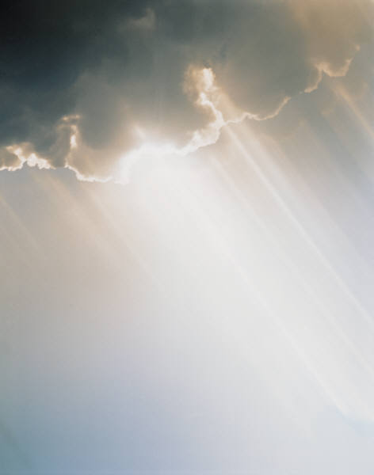
A Stormproof RELIGION
Matthew 7:24-27
All verses are from the NKJV unless noted.

Slide 2
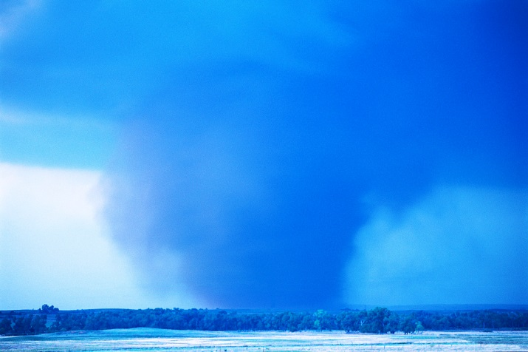
In The Storms Of Life
“STORMPROOF” (ENCARTA)
  Protecting from or withstanding storms
    Able to withstand the wind, rain, or other elements of a storm, or providing protection from them
Many kinds of storms exist in this life
All kinds of measures are taken
  Chasing the storm
  Ignoring the storm
  Providing or seeking shelter
Notes:
What then is a stormproof religion? It is a religion that is able to withstand the storms of life!

Slide 3

Building A Stormproof House
Matthew 7:24-27
Wise Man
Rains, Floods, Wind
ROCK
Foolish Man
Rains, Flood, Wind
SAND
House Built
House Built
Heard Sayings
Heard Sayings
SAME

Slide 4

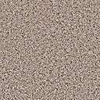
WHAT IS THE DIFFERENCE?
Wise Man
Foolish Man
“Therefore who-ever hears these sayings of Mine, and does them…” (Matt. 7:24)
“But everyone who hears these sayings of Mine, and does not do them…” (Matt. 7:26)
ROCK
SAND

Slide 5
Facts From The Lord’s Teaching
All hearers are builders
All builders fall in one of two classes (wise or foolish)
All builders choose their foundation (rock or sand)
  ROCK (Lk. 6:46-48) → digs deep and obeys
  SAND (Lk. 6:49) → no foundation; did nothing
Notes:
Jesus recognizes the free will of the builder. Some people, though they hear the warning, will not move to prepare.

Slide 6
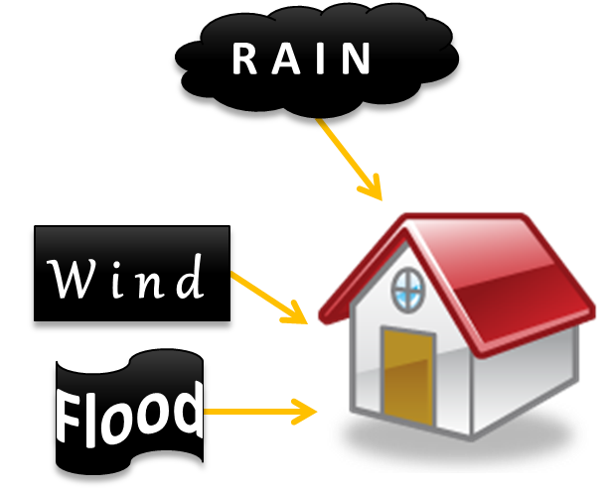

Facts From The Lord’s Teaching
All hearers are builders
All builders fall in one of two classes (wise or foolish)
All builders choose their foundation (rock or sand)
All buildings are tested
Only one kind of
building stands
ROCK
Notes:
Re: all builders are tested. Trial comes upon both the righteous and the wicked. Luke 22:31, 31 – Peter’s storm

Slide 7
Previous To The Lord’s Storm Message (Matt. 7:21-23)
21 "Not everyone who says to Me, ‘Lord, Lord,’ shall enter the kingdom of heaven, but he who does the will of My Father in heaven.
22 "Many will say to Me in that day, ‘Lord, Lord, have we not prophesied in Your name, cast out demons in Your name, and done many wonders in Your name?’
23 "And then I will declare to them, ‘I never knew you; depart from Me, you who practice lawlessness!’
Notes:
Jesus had taught many things previous to this storm message. But He ends His sermon with the call for action and not hearing only.

Slide 8
Previous To The Lord’s Storm Message (Matt. 7:21-23)
Contrasted the mere confessor versus the doer
The foolish man’s house fell:
  He knew of Christ
  Christ did not know him
The wise man’s house stood:
  He obeyed the word and therefore knew Christ
  Christ knew him

Slide 9
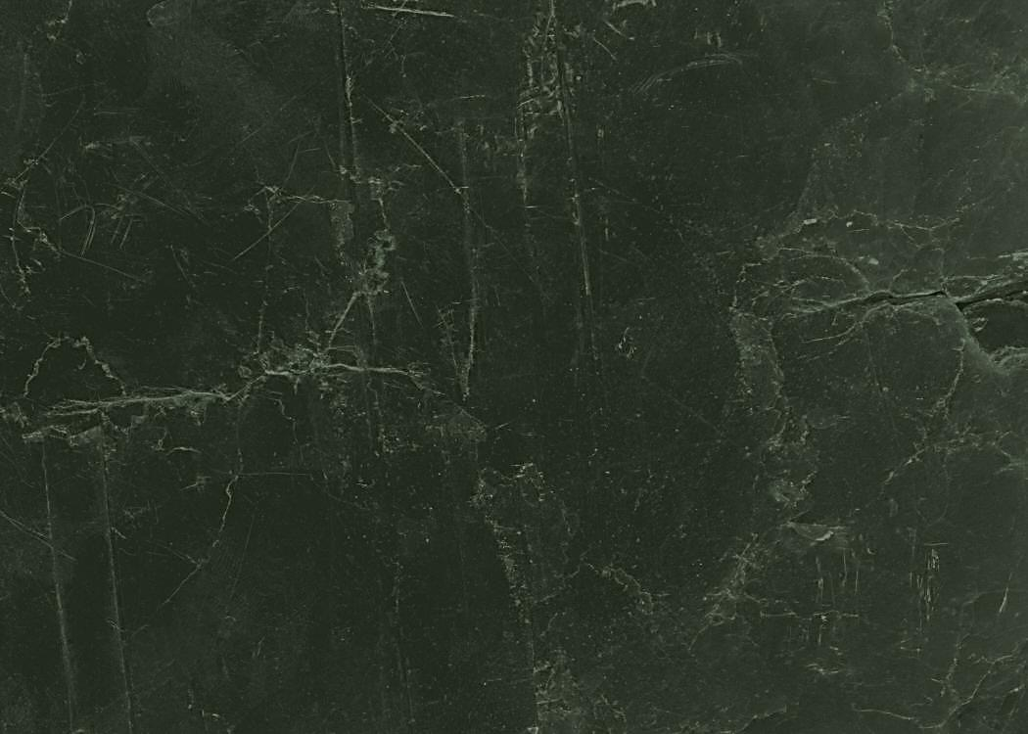
Obedience
Better than a family relationship (Lk. 11:27, 28)
  “If you know these things, blessed are you if you do them” (Jn. 13:17)
Rock solid permanency!
  “For all that is in the world—the lust of the flesh, the lust of the eyes, and the pride of life—is not of the Father but is of the world. And the world is passing away, and the lust of it; but he who does the will of God abides forever” (1 Jn. 2:16, 17)
  Why does he abide forever?

Slide 10
Abiding Forever?
SAYINGS OF JESUS | WILL OF FATHER
OBEDIENCE | ENTRANCE INTO KINGDOM
KINGDOM | FORGIVENESS
Because that builder enters the kingdom of God
  Relationship between sayings of Jesus and the will of the Father (Matt. 7:21, 24)
  Doing His will results in being conveyed into His kingdom (Matt. 7:21; Col. 1:13)
  Results in complete forgiveness and reconciliation (Col. 1:14, 20-23)

Slide 11
Abiding Forever?
Because those who remain in the kingdom of God will abide forever
  Kingdom cannot be destroyed (Dan. 7:14)
  Even though they may die (Jn. 11:25, 26)
  “LIVES & BELIEVES”
  Proven by Christ’s resurrection (1 Cor. 15:20)

Slide 12
Abiding Forever?
“But each one in his own order: Christ the firstfruits, afterward those who are Christ’s at His coming. Then comes the end, when He delivers the kingdom to God the Father, when He puts an end to all rule and all authority and power. For He must reign till He has put all enemies under His feet. The last enemy that will be destroyed is death” (1 Cor. 15:23-26)
Notes:
Each one has his own order.
Christ is the firstfruits and therefore the example of the kind that follows.
WHO? Those who are Christ’s. They know Christ and He knows His own.
WHEN? At His coming. When Jesus comes again, He will raise the dead even as He was raised. This is not a metaphorical resurrection, but a bodily resurrection. This is the END! It is the glorious consummation of the universe project. It is how it comes to a close. Redemption thus comes to an end. There will be no more invitations to the lost. There will be no more time for repentance; no more gospel sermons. Those who are Christ’s are saved. Those who are not, are lost.

Slide 13
Abiding Forever?
“But each one in his own order: Christ the firstfruits, afterward those who are Christ’s at His coming. Then comes the end, when He delivers the kingdom to God the Father, when He puts an end to all rule and all authority and power. For He must reign till He has put all enemies under His feet. The last enemy that will be destroyed is death” (1 Cor. 15:23-26)
Notes:
Note: the kingdom is delivered up to God the Father. The end is not the kingdom’s end. The kingdom is not lost. It is not forgotten, but is brought to its intended purpose, to be delivered up and given to God the Father. The word “deliver” means to give over to one’s personal power and use. The Lord is simply giving back to God the Father what was given Him to do (Jn. 13:3).
The Lord’s rule, as it is now, will come to end because all his enemies have now been successfully conquered—the last of which is death itself. Jesus already conquered death by Himself, yet He will conquer it permanently for us when He comes again.
This does not mean that Jesus will not continue to rule or that He shall pass away in oblivion. He is going to continue to be worshipped, served and adored even as the Father is (see Rev. 22:3). But it is merely His work as redeemer and mediator which comes to an end. In heaven people will not need Jesus to intercede for them on behalf of the Father, but they will have a direct and glorious standing and access to the Father because of Christ’s work on earth. It is a victory whereby we are now one with God and able to sit on Christ’s throne in the way He did the Father’s throne (Rev. 3:21; Jn. 17:24).

Slide 14
Abiding Forever?
  Here is the patience of the saints; here are those who keep the commandments of God and the faith of Jesus. Then I heard a voice from heaven saying to me, "Write: ‘Blessed are the dead who die in the Lord from now on.’" "Yes," says the Spirit, "that they may rest from their labors, and their works follow them."
Revelation 14:12, 13
Notes:
This continues the thought of Revelation 13:10. The patience and faith of the saints is displayed in their ability to maintain the cause of Christ under such terrible persecution. There has never been a time when Christians were trampled than under Rome’s tyrannical rule (Dan. 7:21; Rev. 13:7-10).

Slide 15
What Do We See When We See The PATIENCE OF THE SAINTS (14:12, 13)?
Keeping the commandments of God and the faith of Jesus (faithful obedience)
Keeping the faith despite extreme opposition
  Faithful until death (Rev. 2:10)
Their unjust death (Rev. 6:9)
Their stormproof religion
  Death in Jesus is victory (14:13)
  They are not forgotten (14:13)
Notes:
A good place to end lesson one…see A Strom_Proof RELIGION_1 and 2.

Slide 16
Some Storms To Build Against
Storms of Deceit (Ezek. 13:1-16)
  Preach out of their heart rather than what
  came from God (13:2)
  Hope their word is confirmed (13:6)
  Is nonsense and lies (13:8)
  The storm is coming against their wall (13:10-16)
14 that we should no longer be children, tossed to and fro and carried about with every wind of doctrine, by the trickery of men, in the cunning craftiness of deceitful plotting,
15 but, speaking the truth in love, may grow up in all things into Him who is the head—Christ” (Eph. 4:14, 15)
Notes:
Consider warning and solution (Col. 2:6-8) –beware v. 8; and “root” vers 6, 7.
Stability is in the truth. The word is the measurement and standard for truth. Remedy for deceit is truth. Use the word to test the spirits (1 Jn. 4:1, 2; Rev. 2:2).

Slide 17
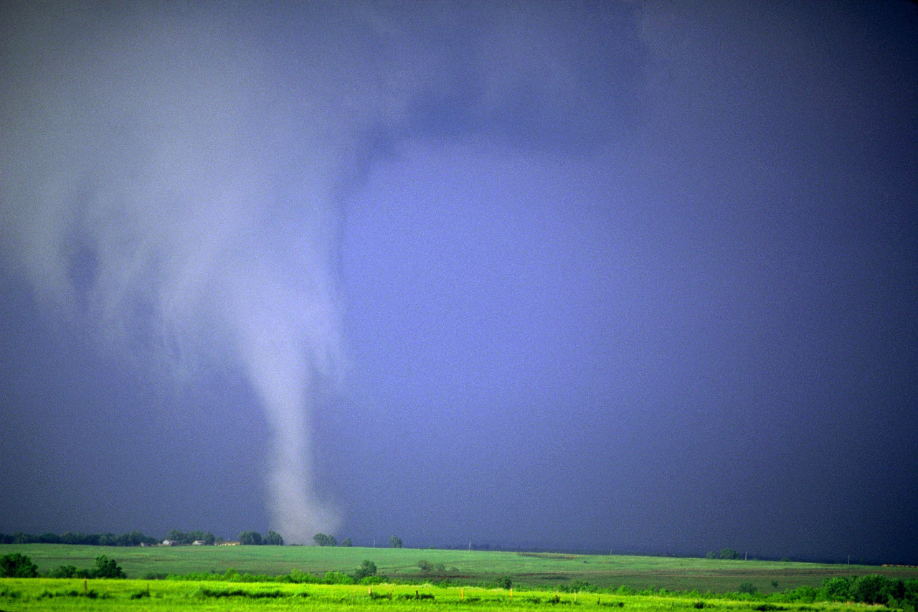
Some Storms To Build Against
Storms of Trial
  Job’s family, “and suddenly a great wind came from across the wilderness and struck the four corners of the house, and it fell on the young people, and they are dead; and I alone have escaped to tell you!“ (Job 1:19)
Notes:
“various trials” (Jas. 1:2).

Slide 18
Some Storms To Build Against
Storms of Trial
  Job’s response, “Then Job arose, tore his robe, and shaved his head; and he fell to the ground and worshiped. And he said: ‘Naked I came from my mother’s womb, And naked shall I return there. The LORD gave, and the LORD has taken away; Blessed be the name of the LORD’” (Job 1:20, 21)
Notes:
Storm proofed in God!

Slide 19
Some Storms To Build Against
Storms of Trial
  Do not need to bear these trials alone (2 Sam. 22:1-7)
  “Trust in Him at all times, you people; Pour out your heart before Him; God is a refuge for us. Selah” (Ps. 62:8)
Notes:
Stephen, though unjustly stoned, was comforted by the ROCK (Acts 7:56). Note Paul’s stormproof religion 2 Tim. 4:6-8 and note “for” as it is related to Timothy’s charge in v. 5. If he wants storm proofed, then he must prepare. Also 2 Tim. 4:16, 17.

Slide 20
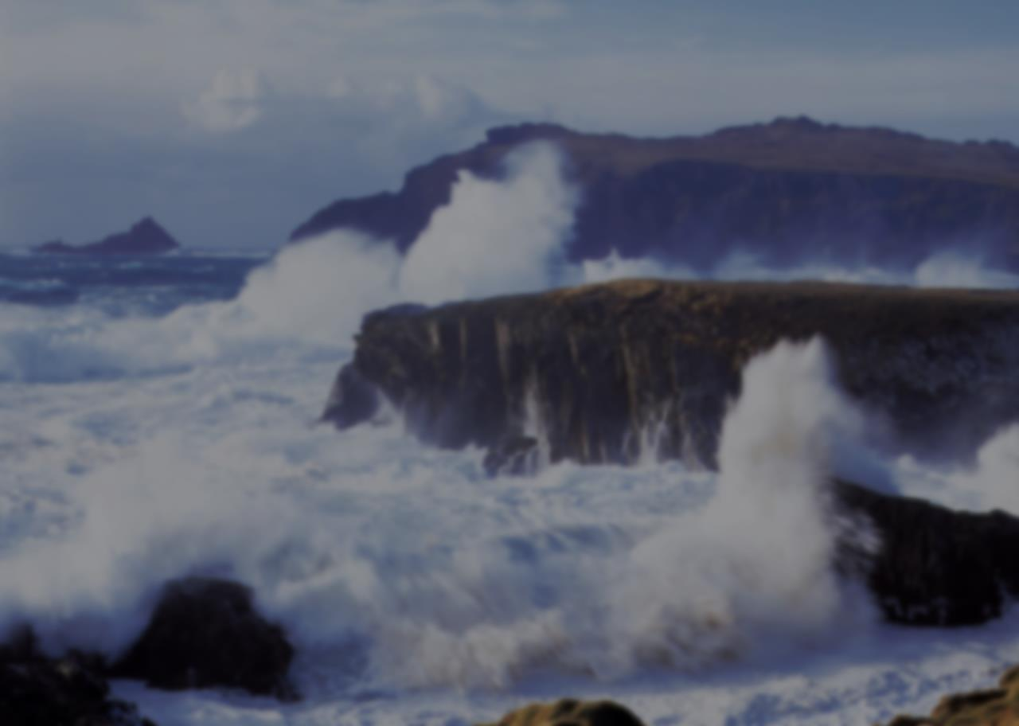
Some Storms To Build Against
Storms of Doubt (Mk. 4:37-40)
  ³⁷ And a great windstorm arose, and the waves beat into the boat, so that it was already filling.
  ³⁸ But He was in the stern, asleep on a pillow. And they awoke Him and said to Him, "Teacher, do You not care that we are perishing?"
  ³⁹ Then He arose and rebuked the wind, and said to the sea, "Peace, be still!" And the wind ceased and there was a great calm.
  ⁴⁰ But He said to them, "Why are you so fearful? How is it that you have no faith?"
Notes:
Doubt is perhaps the most affective whirlwind that the Devil throws at the children of
God.
The real problem was not the wind, the sea, the storm, or even Jesus who was asleep. The real problem was the disciples doubt.
A backdrop to the events could be the revelation of Psalm 107:23-32. These apostles needed to learn to cast their cares upon God and believe in Christ that way. See Paul in Acts 27:21-26 and emp. v. 25 to set us up for what follows.

Slide 21
Some Storms To Build Against
Do you have faith in:
  “Yea, though I walk through the valley of the shadow of death, I will fear no evil; For You are with me; Your rod and Your staff, they comfort me” (Ps. 23:4)
  “No temptation has overtaken you except such as is common to man; but God is faithful, who will not allow you to be tempted beyond what you are able, but with the temptation will also make the way of escape, that you may be able to bear it”
  (1 Cor. 10:13)

Slide 22
Some Storms To Build Against
Do you have faith in:
  “For if we believe that Jesus died and rose again, even so God will bring with Him those who sleep in Jesus” (1 Thess. 4:14)
  “There is one body and one Spirit, just as you were called in one hope of your calling; one Lord, one faith, one baptism; one God and Father of all, who is above all, and through all, and in you all” (Eph. 4:4-6)

Slide 23
Some Storms To Build Against
Do you have faith in:
  “But the cowardly, unbelieving, abominable, murderers, sexually immoral, sorcerers, idolaters, and all liars shall have their part in the lake which burns with fire and brimstone, which is the second death”
  (Rev. 21:8)
  “And having been perfected, He became the author of eternal salvation to all who obey Him” (Heb. 5:9)

Slide 24
Some Storms To Build Against
Do you have faith in:
  “Truly, these times of ignorance God overlooked, but now commands all men everywhere to repent” (Acts 17:30)
  “because He has appointed a day on which He will judge the world in righteousness by the Man whom He has ordained. He has given assurance of this to all by raising Him from the dead” (Acts 17:31)

Slide 25
Some Storms To Build Against
Do you have faith in:
  “…And I will give to each one of you according to your works” (Rev. 2:23)
  “He who shall believe, and be immersed, shall be saved; but he who shall not believe, shall be condemned” (Mk. 16:16, LO)
  “For yet a little while, And He who is coming will come and will not tarry. Now the just shall live by faith; But if anyone draws back, My soul has no pleasure in him” (Heb. 10:37, 38)

Slide 26
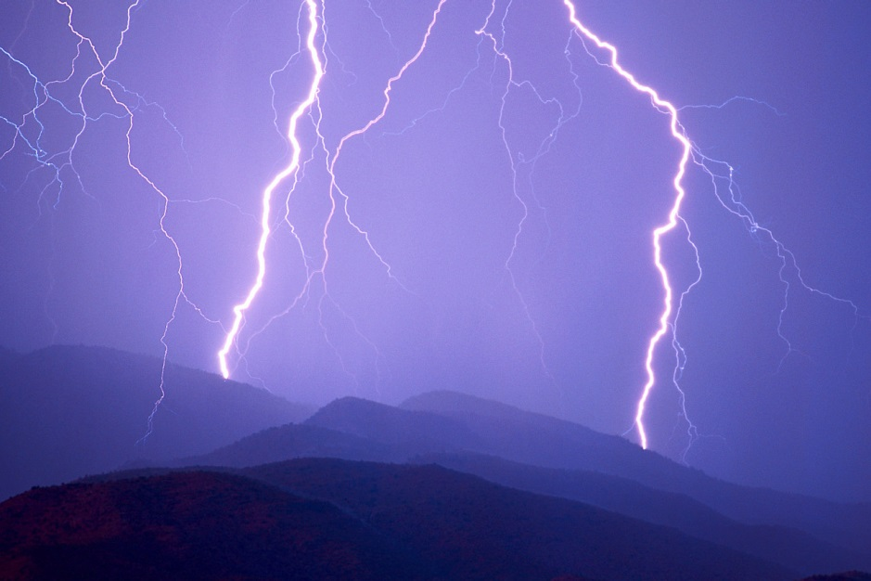
WILL YOU BEGIN BUILDING A STORMPROOF RELIGION TODAY?

